Slide 1
Linear Algebra
Chapter 4
Matrices

Slide 2
Agenda
Matrices

Slide 3
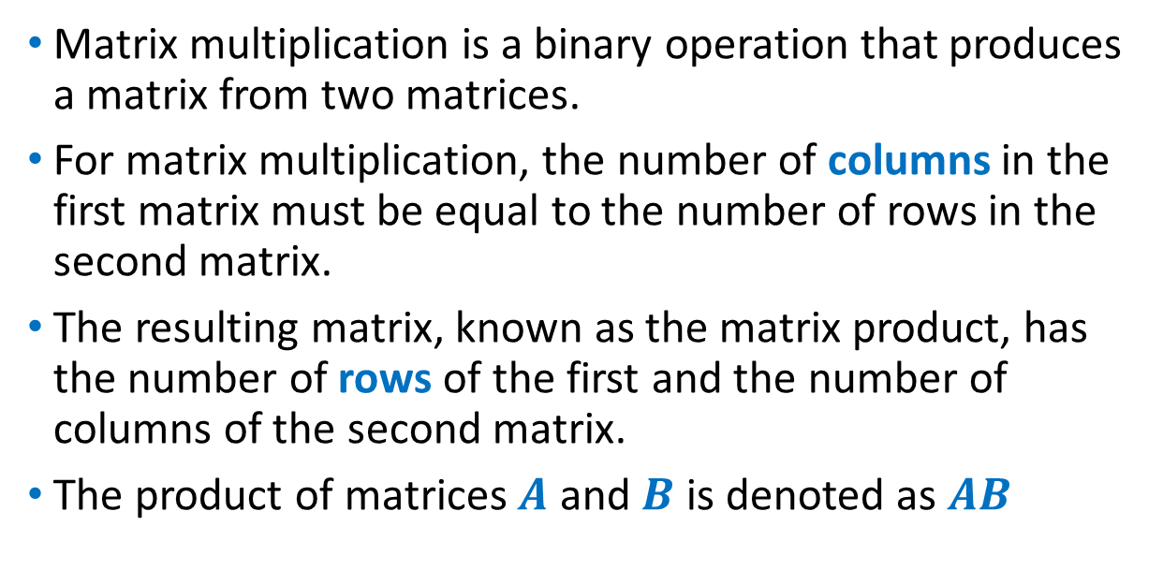
Matrix Multiplication
Matrix multiplication is a binary operation that produces a matrix from two matrices.
For matrix multiplication, the number of columns in the first matrix must be equal to the number of rows in the second matrix.
The resulting matrix, known as the matrix product, has the number of rows of the first and the number of columns of the second matrix.
The product of matrices $A$ and $B$ is denoted as $AB$

Slide 4
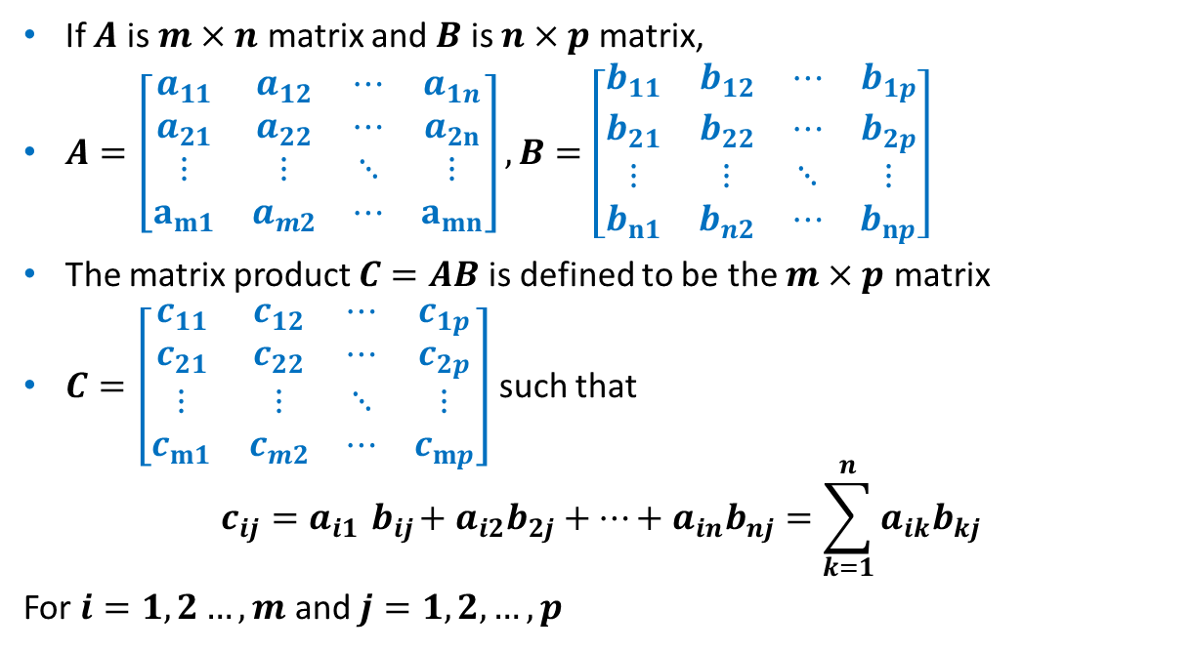
Matrix Multiplication
If $A$ is $m×n$ matrix and $B$ is $n×p$ matrix,
$A=\left[\begin{matrix}a_{11} & a_{12} & ⋯ & a_{1n} \\ a_{21} & a_{22} & ⋯ & a_{2n} \\ ⋮ & ⋮ & ⋱ & ⋮ \\ a_{m1} & a_{m2} & ⋯ & a_{mn}\end{matrix}\right], B=\left[\begin{matrix}b_{11} & b_{12} & ⋯ & b_{1p} \\ b_{21} & b_{22} & ⋯ & b_{2p} \\ ⋮ & ⋮ & ⋱ & ⋮ \\ b_{n1} & b_{n2} & ⋯ & b_{np}\end{matrix}\right]$
The matrix product $C=AB$ is defined to be the $m×p$ matrix
$C=\left[\begin{matrix}c_{11} & c_{12} & ⋯ & c_{1p} \\ c_{21} & c_{22} & ⋯ & c_{2p} \\ ⋮ & ⋮ & ⋱ & ⋮ \\ c_{m1} & c_{m2} & ⋯ & c_{mp}\end{matrix}\right]$ such that
$$c_{ij}=a_{i1}{ b}_{ij}+a_{i2}b_{2j}+…+a_{in}b_{nj}=\sum_{k=1}^{n}{a_{ik}b_{kj}}$$
For $i=1,2…,m$ and $j=1,2,…,p$

Slide 5
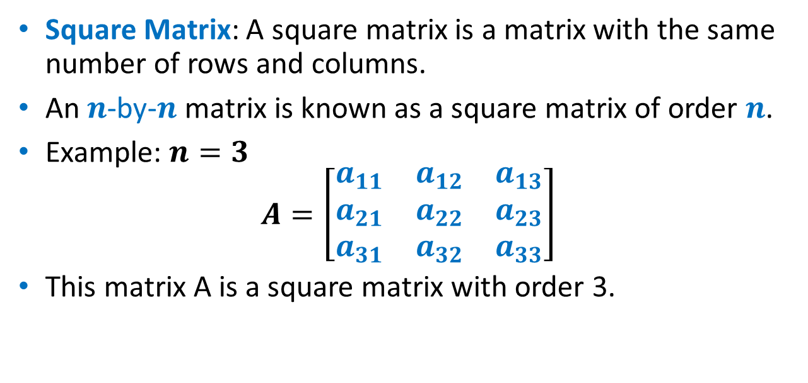
Square Matrix
Square Matrix: A square matrix is a matrix with the same number of rows and columns.
An $n$-by-$n$ matrix is known as a square matrix of order $n$.
Example: $n=3$
$$A=\left[\begin{matrix}a_{11} & a_{12} & a_{13} \\ a_{21} & a_{22} & a_{23} \\ a_{31} & a_{32} & a_{33}\end{matrix}\right]$$
This matrix A is a square matrix with order 3.

Slide 6
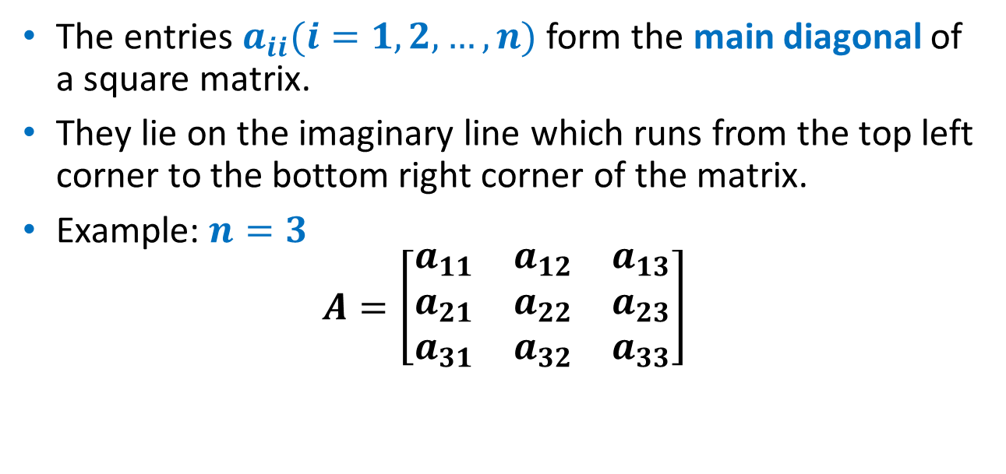
Main diagonal
The entries $a_{ii}(i=1,2,…,n)$ form the main diagonal of a square matrix.
They lie on the imaginary line which runs from the top left corner to the bottom right corner of the matrix.
Example: $n=3$
$$A=\left[\begin{matrix}a_{11} & a_{12} & a_{13} \\ a_{21} & a_{22} & a_{23} \\ a_{31} & a_{32} & a_{33}\end{matrix}\right]$$
Main Diagonal

Slide 7
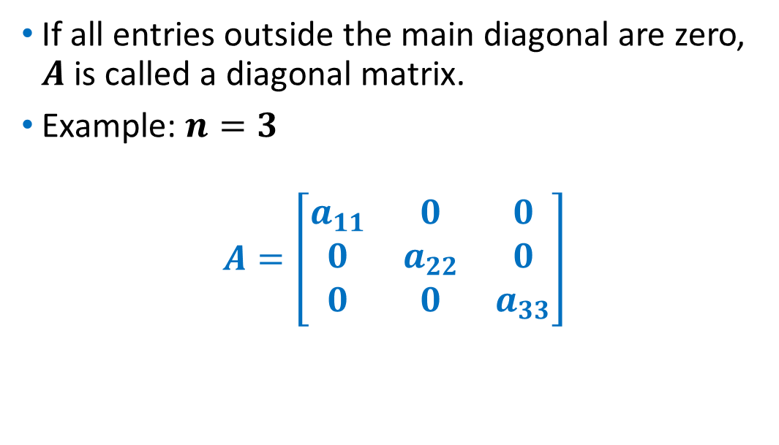
Diagonal Matrix
If all entries outside the main diagonal are zero, $A$ is called a diagonal matrix.
Example: $n=3$
$$A=\left[\begin{matrix}a_{11} & 0 & 0 \\ 0 & a_{22} & 0 \\ 0 & 0 & a_{33}\end{matrix}\right]$$

Slide 8
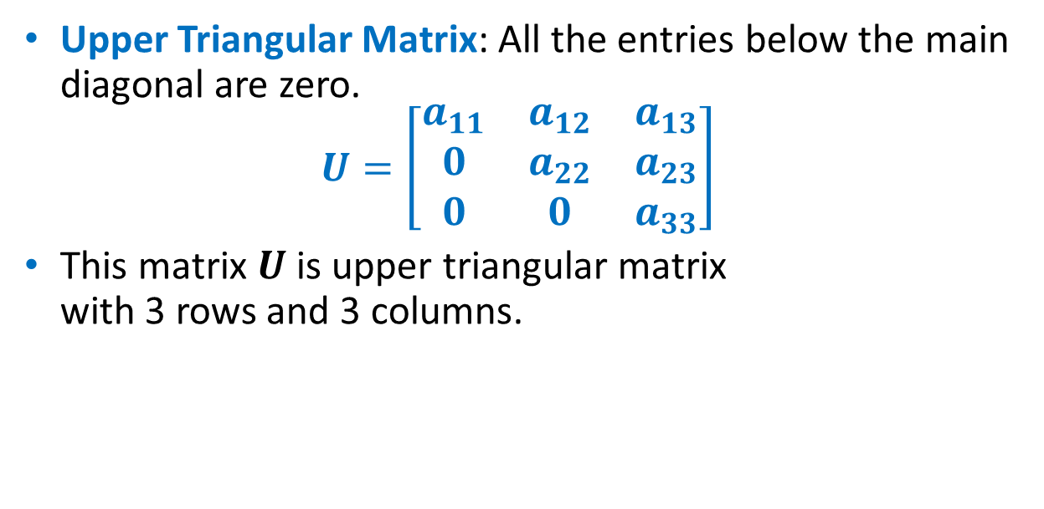
Upper Triangular Matrix
Upper Triangular Matrix: All the entries below the main diagonal are zero.
$$U=\left[\begin{matrix}a_{11} & a_{12} & a_{13} \\ 0 & a_{22} & a_{23} \\ 0 & 0 & a_{33}\end{matrix}\right]$$
This matrix $U$ is upper triangular matrix with 3 rows and 3 columns.

Slide 9
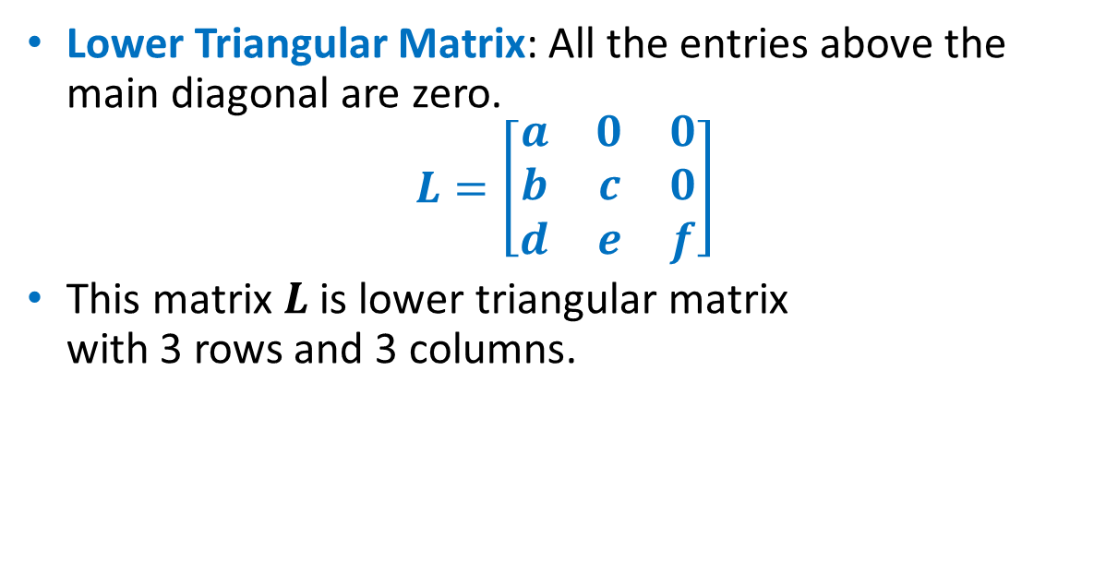
Lower Triangular Matrix
Lower Triangular Matrix: All the entries above the main diagonal are zero.
$$L=\left[\begin{matrix}a & 0 & 0 \\ b & c & 0 \\ d & e & f\end{matrix}\right]$$
This matrix $L$ is lower triangular matrix with 3 rows and 3 columns.

Slide 10
2 Quiz-Cannot handle 'fill-in-the-blank' in 'iSpring'

Slide 11
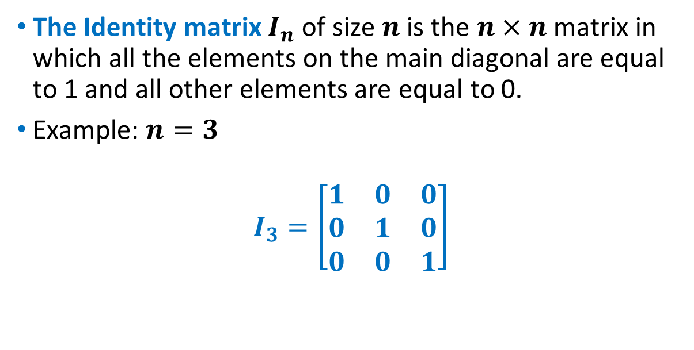
Identity Matrix
The Identity matrix $I_{n}$ of size $n$ is the $n×n$ matrix in which all the elements on the main diagonal are equal to 1 and all other elements are equal to 0.
Example: $n=3$
$$I_{3}=\left[\begin{matrix}1 & 0 & 0 \\ 0 & 1 & 0 \\ 0 & 0 & 1\end{matrix}\right]$$

Slide 12
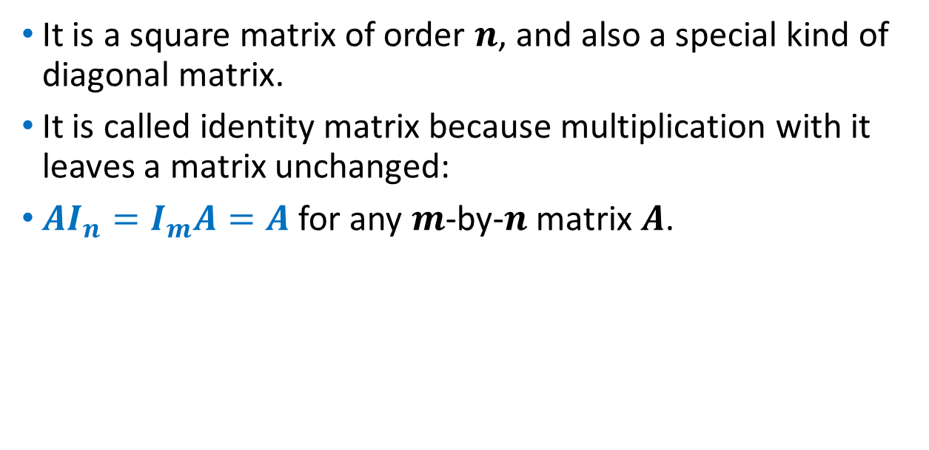
Identity Matrix
It is a square matrix of order $n$, and also a special kind of diagonal matrix.
It is called identity matrix because multiplication with it leaves a matrix unchanged:
$AI_{n}=I_{m}A=A$ for any $m$-by-$n$ matrix $A$.

Slide 13

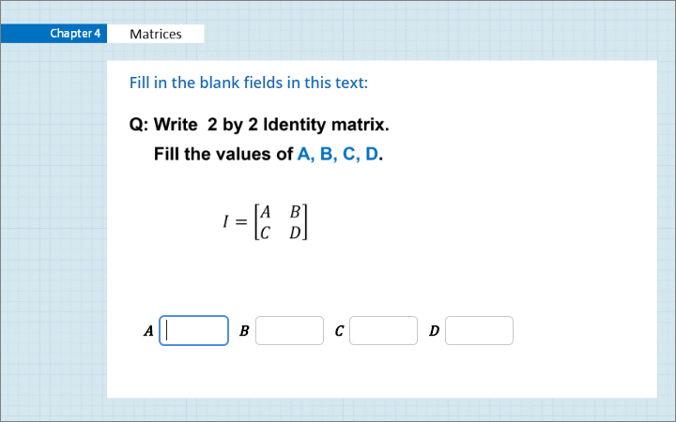
Quiz
Click the Quiz button to edit this object

Slide 14
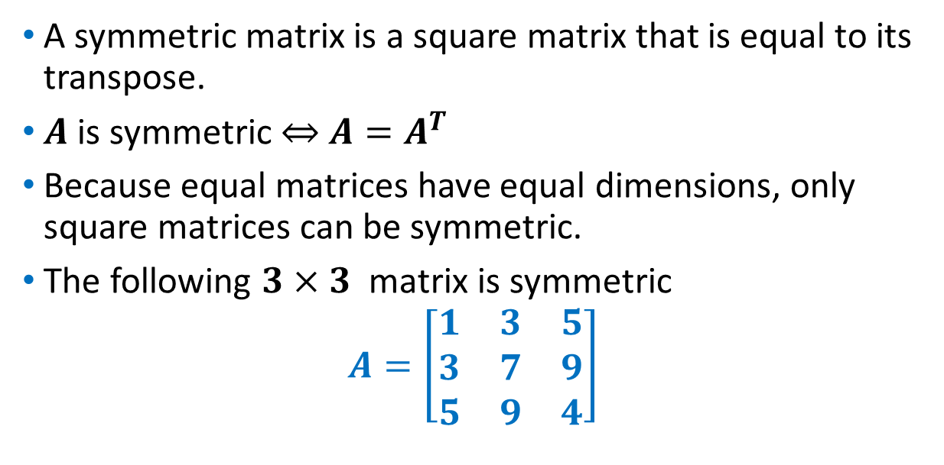
Symmetric Matrix
A symmetric matrix is a square matrix that is equal to its transpose.
$A$ is symmetric $⇔$ $A=A^{T}$
Because equal matrices have equal dimensions, only square matrices can be symmetric.
The following $3×3$ matrix is symmetric
$$A=\left[\begin{matrix}1 & 3 & 5 \\ 3 & 7 & 9 \\ 5 & 9 & 4\end{matrix}\right]$$

Slide 15
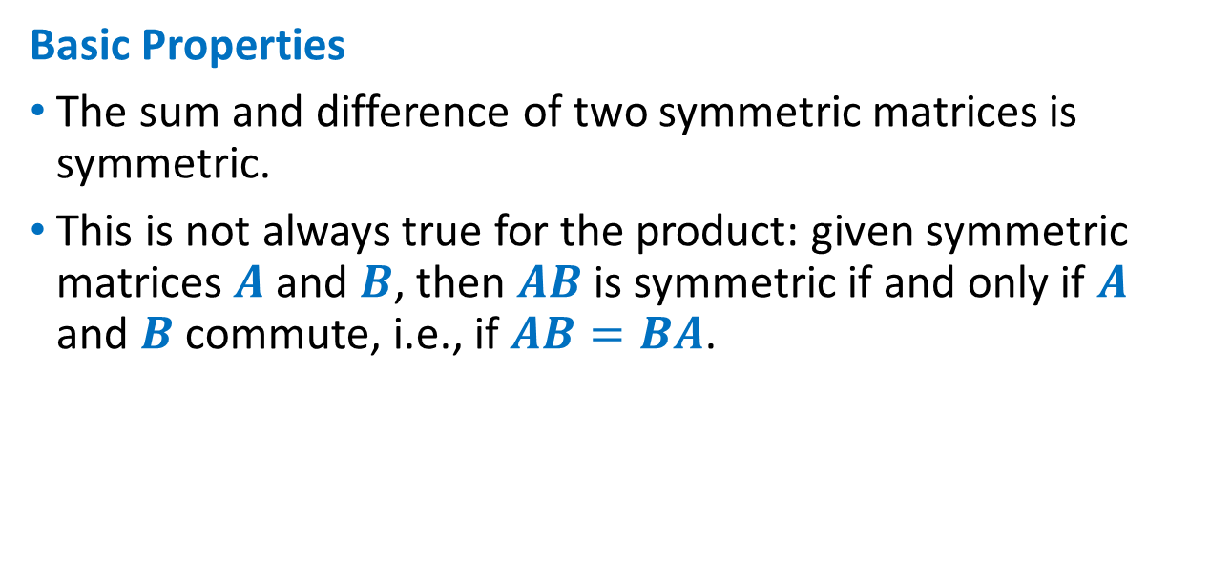
Symmetric Matrix
Basic Properties
The sum and difference of two symmetric matrices is symmetric.
This is not always true for the product: given symmetric matrices $A$ and $B$, then $AB$ is symmetric if and only if $A$ and $B$ commute, i.e., if $AB=BA$.

Slide 16

Symmetric Matrix
Basic Properties
For any integer $n$, $A^{n}$ is symmetric if $A$ is symmetric.
If $A^{−1}$ exists, it is symmetric if and only if $A$ is symmetric.

Slide 17
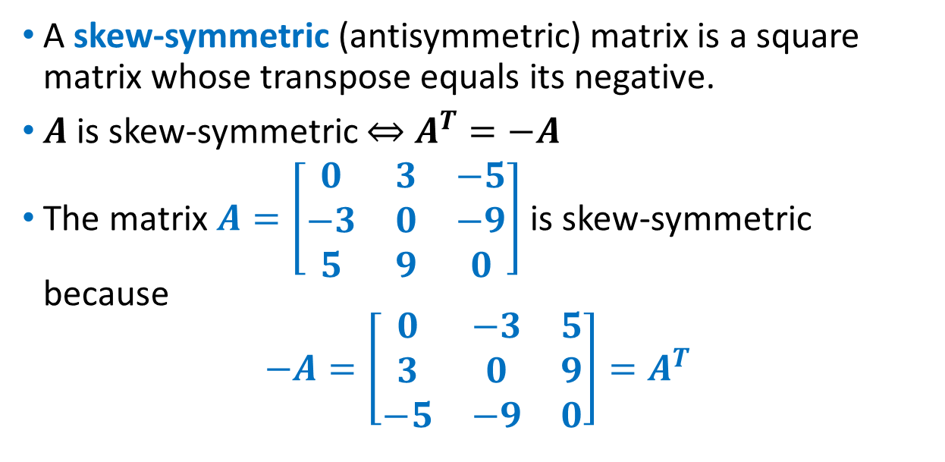
Skew-symmetric Matrix
A skew-symmetric (antisymmetric) matrix is a square matrix whose transpose equals its negative.
$A$ is skew-symmetric $⇔$ $A^{T}=−A$
The matrix $A=\left[\begin{matrix}0 & 3 & −5 \\ −3 & 0 & −9 \\ 5 & 9 & 0\end{matrix}\right]$ is skew-symmetric because
$$−A=\left[\begin{matrix}0 & −3 & 5 \\ 3 & 0 & 9 \\ −5 & −9 & 0\end{matrix}\right]=A^{T}$$

Slide 18
Quiz-Cannot handle 'fill-in-the-blank' in 'iSpring'

Slide 19
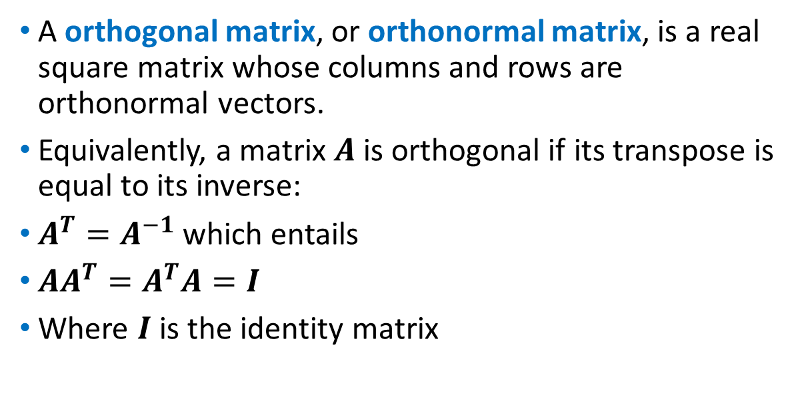
Orthogonal Matrix
A orthogonal matrix, or orthonormal matrix, is a real square matrix whose columns and rows are orthonormal vectors.
Equivalently, a matrix $A$ is orthogonal if its transpose is equal to its inverse:
$A^{T}=A^{−1}$ which entails
$AA^{T}=A^{T}A=I$
Where $I$ is the identity matrix

Slide 20
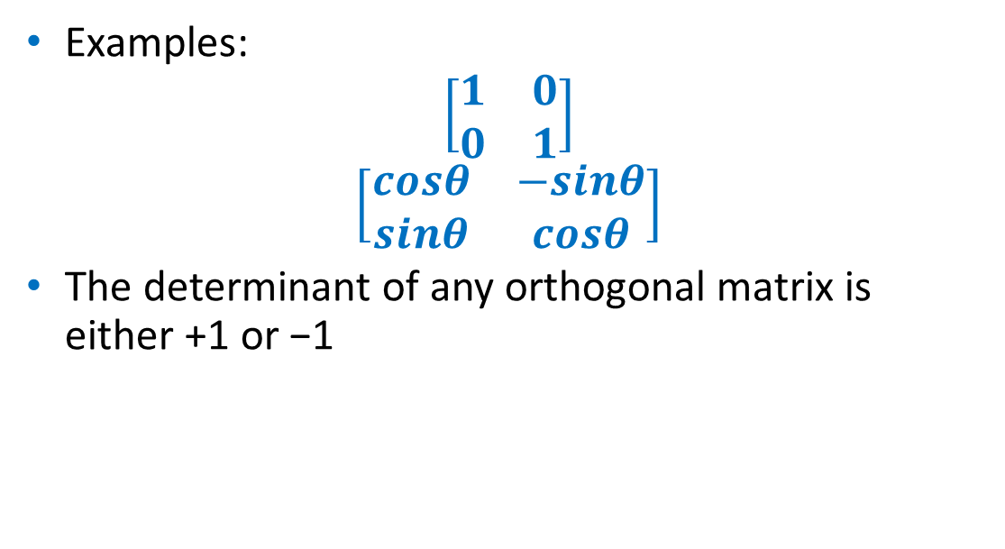
Orthogonal Matrix
Examples:
$$\left[\begin{matrix}1 & 0 \\ 0 & 1\end{matrix}\right]$$
$$\left[\begin{matrix}cosθ & −sinθ \\ sinθ & cosθ\end{matrix}\right]$$
The determinant of any orthogonal matrix is either +1 or −1

Slide 21

Trace
The trace of a square matrix $A$, denoted $tr\left(A\right),$ is defined to be the sum of elements on the main diagonal (from the upper left to the lower right) of $A$.
The trace is only defined for a square matrix $(n×n)$.

Slide 22

Trace
The trace of an $n×n$ square matrix $A$ is defined as
$$tr\left(A\right)=\sum_{i=1}^{n}{a_{ii}}=a_{11}+a_{22}+…+a_{nn}$$
where $a_{ii}$ denotes the entry on the $i^{th}$row and $i^{th}$ column of $A$

Slide 23
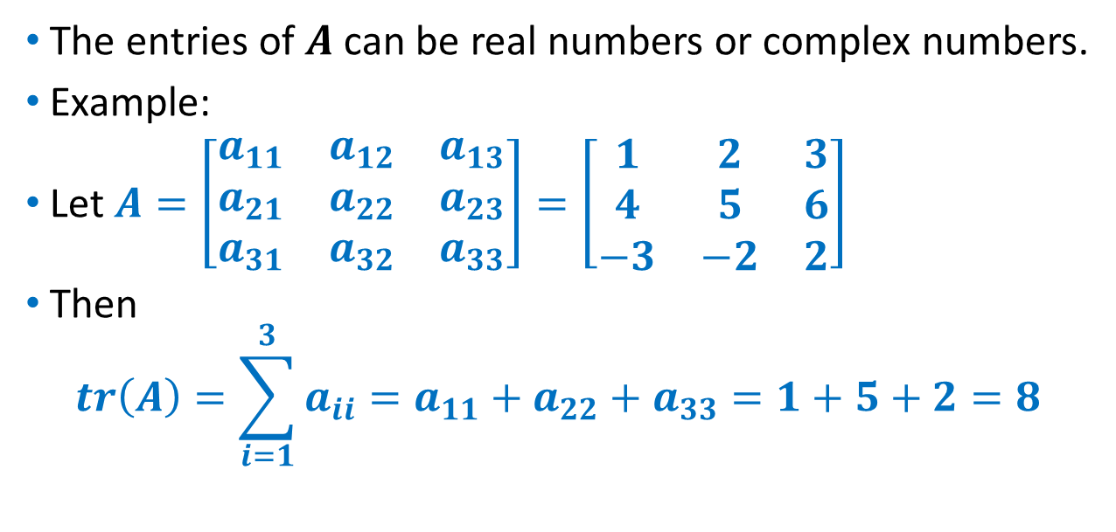
Trace
The entries of $A$ can be real numbers or complex numbers.
Example:
Let $A=\left[\begin{matrix}a_{11} & a_{12} & a_{13} \\ a_{21} & a_{22} & a_{23} \\ a_{31} & a_{32} & a_{33}\end{matrix}\right]=\left[\begin{matrix}1 & 2 & 3 \\ 4 & 5 & 6 \\ −3 & −2 & 2\end{matrix}\right]$
Then
$$tr\left(A\right)=\sum_{i=1}^{3}{a_{ii}=a_{11}+a_{22}+a_{33}=1+5+2=8}$$

Slide 24

Trace
Basic properties:
$tr\left(A+B\right)=tr\left(A\right)+tr\left(B\right)$
$tr\left(cA\right)=c tr(A)$
$tr\left(A\right)=tr(A^{T})$

Slide 25
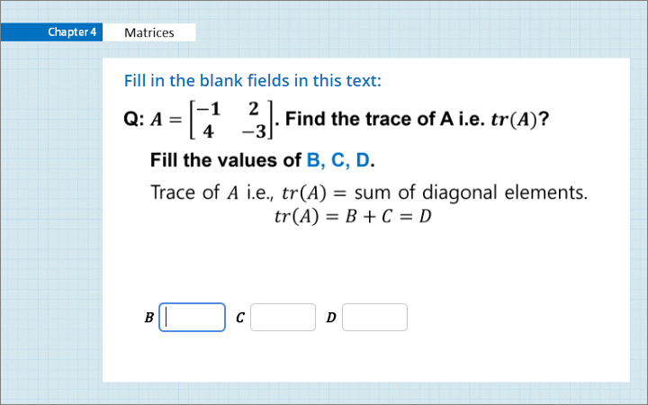
Quiz
Click the Quiz button to edit this object

Slide 26
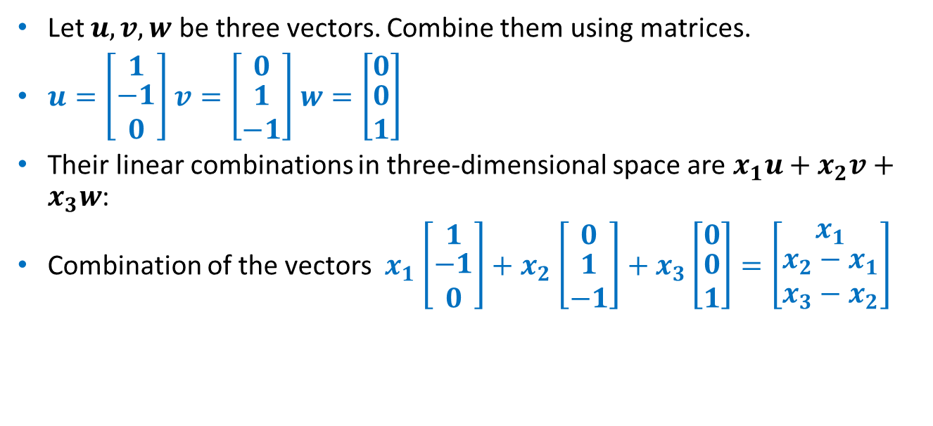
Matrices
Let $u,v,w$ be three vectors. Combine them using matrices.
$u=\left[\begin{matrix}1 \\ \begin{aligned}−1 \\ 0\end{aligned}\end{matrix}\right]$ $v=\left[\begin{matrix}0 \\ \begin{aligned}1 \\ −1\end{aligned}\end{matrix}\right]$ $w=\left[\begin{matrix}0 \\ \begin{aligned}0 \\ 1\end{aligned}\end{matrix}\right]$
Their linear combinations in three-dimensional space are $x_{1}u+x_{2}v+x_{3}w$:
Combination of the vectors $x_{1}$ $\left[\begin{matrix}1 \\ \begin{aligned}−1 \\ 0\end{aligned}\end{matrix}\right]+x_{2}$ $\left[\begin{matrix}0 \\ \begin{aligned}1 \\ −1\end{aligned}\end{matrix}\right]+x_{3}\left[\begin{matrix}0 \\ \begin{aligned}0 \\ 1\end{aligned}\end{matrix}\right]=\left[\begin{matrix}x_{1} \\ \begin{aligned}x_{2}−x_{1} \\ x_{3}−x_{2}\end{aligned}\end{matrix}\right]$

Slide 27
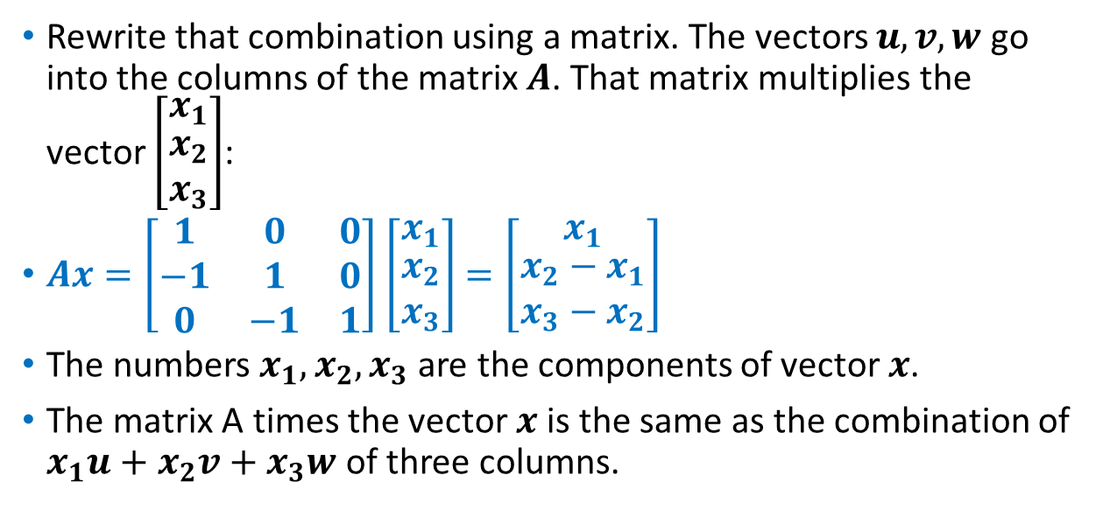
Matrices
Rewrite that combination using a matrix. The vectors $u,v,w$ go into the columns of the matrix $A$. That matrix multiplies the vector $\left[\begin{matrix}x_{1} \\ \begin{aligned}x_{2} \\ x_{3}\end{aligned}\end{matrix}\right]$:
$Ax=\left[\begin{matrix}1 & 0 & 0 \\ −1 & 1 & 0 \\ 0 & −1 & 1\end{matrix}\right]$ $\left[\begin{matrix}x_{1} \\ \begin{aligned}x_{2} \\ x_{3}\end{aligned}\end{matrix}\right]$ $=\left[\begin{matrix}x_{1} \\ \begin{aligned}x_{2}−x_{1} \\ x_{3}−x_{2}\end{aligned}\end{matrix}\right]$
The numbers $x_{1},x_{2},x_{3}$ are the components of vector $x$.
The matrix A times the vector $x$ is the same as the combination of $x_{1}u+x_{2}v+x_{3}w$ of three columns.
Matrix time vector
Combination of columns

Slide 28
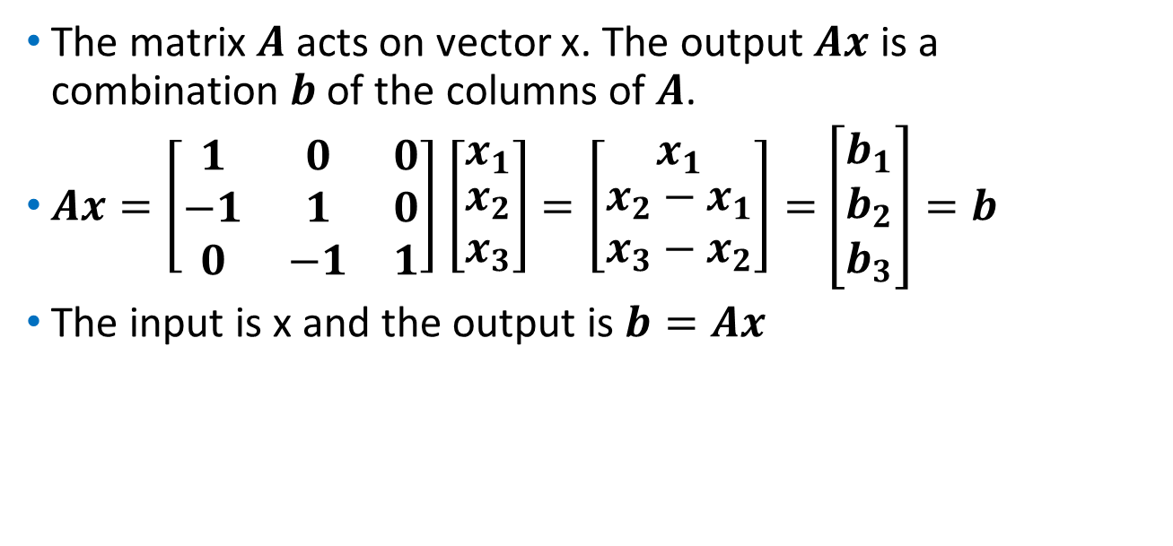
Matrices
The matrix $A$acts on vector x. The output $Ax$ is a combination $b$ of the columns of $A$.
$Ax=\left[\begin{matrix}1 & 0 & 0 \\ −1 & 1 & 0 \\ 0 & −1 & 1\end{matrix}\right]$ $\left[\begin{matrix}x_{1} \\ \begin{aligned}x_{2} \\ x_{3}\end{aligned}\end{matrix}\right]$ $=\left[\begin{matrix}x_{1} \\ \begin{aligned}x_{2}−x_{1} \\ x_{3}−x_{2}\end{aligned}\end{matrix}\right]=$ $\left[\begin{matrix}b_{1} \\ \begin{aligned}b_{2} \\ b_{3}\end{aligned}\end{matrix}\right]=b$
The input is x and the output is $b=Ax$

Slide 29
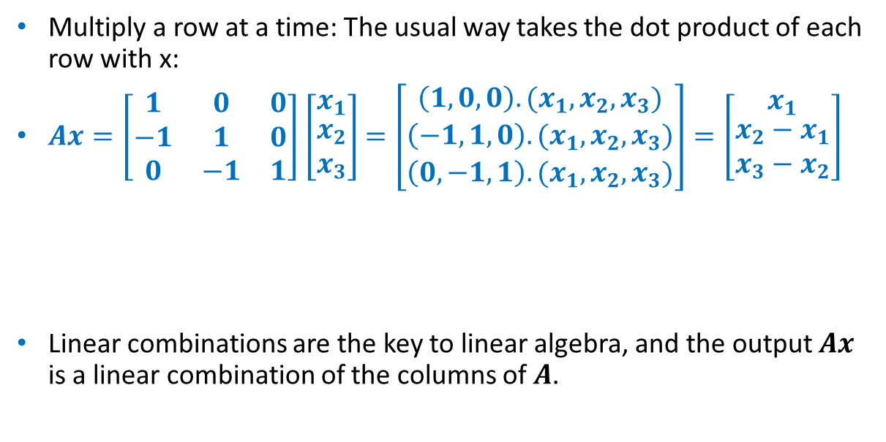
Matrices
Multiply a row at a time: The usual way takes the dot product of each row with x:
$Ax=\left[\begin{matrix}1 & 0 & 0 \\ −1 & 1 & 0 \\ 0 & −1 & 1\end{matrix}\right]$ $\left[\begin{matrix}x_{1} \\ \begin{aligned}x_{2} \\ x_{3}\end{aligned}\end{matrix}\right]$ $=\left[\begin{matrix}{\left(1,0,0\right).(x}_{1},x_{2},x_{3}) \\ \begin{aligned}\left(−1,1,0\right).(x_{1},x_{2},x_{3}) \\ \left(0,−1,1\right).(x_{1},x_{2},x_{3})\end{aligned}\end{matrix}\right]=\left[\begin{matrix}x_{1} \\ \begin{aligned}x_{2}−x_{1} \\ x_{3}−x_{2}\end{aligned}\end{matrix}\right]$
Linear combinations are the key to linear algebra, and the output $Ax$ is a linear combination of the columns of $A$.
Ax is also dot products
with rows.

Slide 30
Summary
Matrices

